Slide 1
6.2: Linear Regression
Kamilah Ebrahim
The University of Toronto
6.2: Linear Regression

Slide 2
Motivation (Python)
Throughout this Module we will be making use of the Boston dataset in the Python package ISLP. We can use the terminal to install the Python package and use the load_data function from the ISLP package to load the Boston dataset:
pip install ISLP
from ISLP import load_data Boston = load_data("Boston")
The Boston dataset contains housing values in 506 Boston suburbs along with 12 other variables associated with the suburbs. To name a few,
rm: average number of rooms per dwelling
nox: nitrogen oxides concentration (parts per 10 million)
lstat: percent of households with low socioeconomic status
We can take medv, the median value of owner-occupied homes in $1000s, to be the response variable 𝑌 and the 12 other variables to be the predictors 𝑋 = (𝑋₁, … , 𝑋₁₂).
6.2: Linear Regression

Slide 3
Motivation
There may be some specific question we’d like to address
Is there a relationship between the 12 variables and housing price?
Does the data provide evidence of an association?
Are all of the 12 variables associated with housing price?
Perhaps only a few of the variables have an effect on housing price.
How accurate are the predictions for housing prices based on these variables? Is the relationship between the variables and housing price linear?
Perhaps we can transform some variables to make the relationship linear.
All of these questions can be answered using linear regression!
6.2: Linear Regression

Slide 4
Simple Linear Regression
Simple linear regression uses a single predictor variable 𝑋 to predict a quantitative response
𝑌 by assuming the relationship between them is linear.
𝑌 ≈ 𝛽₀ + 𝛽₁𝑋
𝛽₀ and 𝛽₁ are the model parameters which are unknown.
𝛽₀ is the intercept term and 𝛽₁ is the slope term.
We can use the training data to produce estimates 𝛽₀̂ and 𝛽₁̂ and predict future responses
𝑦̂ ≈ 𝛽₀̂ + 𝛽₁̂ 𝑋
6.2: Linear Regression

Slide 5
Estimating the Coeﬀicients
Suppose we have 𝑛 observations in our training data which each consists of a measurement for
𝑋 and 𝑌 represented by
(𝑥₁, 𝑦₁), (𝑥₂, 𝑦₂), … , (𝑥_{𝑛}, 𝑦_{𝑛})
We want to find estimates for 𝛽₀̂ and 𝛽₁
̂ such that for all 𝑖 = 1, … , 𝑛
𝑦_{𝑖} ≈ 𝑦_{𝑖}
where 𝑦_{𝑖}̂ = 𝛽₀̂ + 𝛽₁̂ 𝑥_{𝑖} is the prediction for 𝑦_{𝑖} given 𝑥_{𝑖}.
The most common method used to measure the difference between 𝑦_{𝑖} and 𝑦_{𝑖}̂ is the least squares criterion. The idea being that we want to find the 𝛽₀̂ and 𝛽₁̂ that give us the smallest difference.
6.2: Linear Regression

Slide 6
Least Squares Criterion
We define the 𝑖th residual to be the difference between the 𝑖th observed response value and the 𝑖th predicted response value:
𝑒_{𝑖} = 𝑦_{𝑖} − 𝑦_{𝑖}
The residual sum of squares (RSS) is the following
2 2
̂ ̂ ̂
RSS = 𝑒₁ + ⋯ + 𝑒_{𝑛} = (𝑦₁ − 𝛽₀ − 𝛽₁𝑥₁) + ⋯ + (𝑦_{𝑛} − 𝛽₀ − 𝛽₁𝑥_{𝑛})
The RSS is minimized by the estimates below (where 𝑥,̄ 𝑦̄ are the sample means):
∑𝑛
(𝑥 − 𝑥)̄ (𝑦 − 𝑦)
_{𝛽} ̂ ₌ 𝑖=1 ^{𝑖 𝑖}
1
∑𝑛
(𝑥 − 𝑥)̄ ²
𝑖=1
𝑖
𝛽₀̂ = 𝑦̄ − 𝛽₁̂ 𝑥
So 𝛽₁̂ and 𝛽₀̂ definte the least squares coeﬀicient estimates
6.2: Linear Regression

Slide 7
Assessing the Accuracy of the Coeﬀicient Estimates
Recall from section 6.1 that we assume the true relationship between the predictor 𝑋 and the response 𝑌 is
𝑌 = 𝑓(𝑋) + 𝜖
where 𝑓 is an unknown function and 𝜖 is the random error with mean zero. By assuming 𝑓 is linear, we obtain
𝑌 = 𝛽₀ + 𝛽₁𝑋 + 𝜖
Now suppose we have the least squares coeﬀicient estimates 𝛽₀̂ and 𝛽₁̂ , so
𝑌̂ = 𝛽₀̂ + 𝛽₁̂ 𝑋
We would like to assess the how close 𝛽₀̂ and 𝛽₁̂ are to the true parameter values 𝛽₀ and 𝛽₁.
6.2: Linear Regression

Slide 8
Standard Error
We can compute the standard erorrs associated with 𝛽₀
̂ and 𝛽₁
̂ with the following:
̂ 2
1
_{𝑥}2
̄ ̂ 2
_{𝜎}2
SE (𝛽₀) = 𝜎 [ _{𝑛} + _{∑𝑛}
2
] ,
(𝑥 − 𝑥)̄ ²
SE (𝛽₁) =
∑𝑛
(𝑥 − 𝑥)̄ ²
𝑖=1
𝑖=1
where 𝜎² = Var(𝜖) and is usually unknown. Luckily, 𝜎 can be estimated from the data using the residual standard error (RSE)
RSE = √ ^{RSS}
(𝑛 − 2)
The standard errors for 𝛽₀̂ and 𝛽₁̂ can be used to compute confidence intervals of the estimates or perform hypothesis tests on the coeﬀicients.
6.2: Linear Regression

Slide 9
Hypothesis Tests on the Coeﬀicients
Once we have the standard errors, we can perform a hypothesis test on the coeﬀicients to determine whether there is a relationship between 𝑋 and 𝑌 .
The null hypothesis is
𝐻₀ ∶ There is no relationship between 𝑋 and 𝑌
and the alternative hypothesis is
𝐻_{𝑎} ∶ There is some relationship between 𝑋 and 𝑌
Mathematically, this is
𝐻₀ ∶ 𝛽₁ = 0 versus 𝐻_{𝑎} ∶ 𝛽₁ ≠ 0
since if 𝛽₁ = 0 then 𝑌 = 𝛽₀ + 𝜖 so 𝑌 is not associated with 𝑋.
6.2: Linear Regression

Slide 10
Hypothesis Tests on the Coeﬀicients
In order to test the null hypothesis, we need to determine whether 𝛽₁
zero. The t-statistic
𝛽₁̂ − 0
𝑡 =
̂ is suﬀiciently far from
SE(𝛽₁̂ )
measures the number of standard deviations that 𝛽₁̂ is away from 0. The 𝑝-value can be computed from the 𝑡-statistic which will allow us to either accept or reject our null hypothesis.
6.2: Linear Regression

Slide 11
Assessing the Accuracy of the Model
The quality of the linear regression fit is often assessed with the residual standard error (RSE) and the 𝑅² statistic.
The RSE gives an absolute measure of lack of fit of the model to the data.
The R² statistic measures the proportion of variability in 𝑌 that can be explained by 𝑋.
We’ve already seen how the RSE is computed from the RSS and the 𝑅² statistic can be computed using
𝑅² = 1 − ^{RSS}
TSS
2
where TSS = ∑ (𝑦 − 𝑦)̄ is the total sum of squares which measures the amount of
𝑖
variability in the responses before regression is performed.
6.2: Linear Regression

Slide 12
Simple Linear Regression Summary
Simple linear regression uses a single predictor variable 𝑋 to predict a response 𝑌 with
𝑌 ≈ 𝛽₀ + 𝛽₁𝑋
𝛽₀, 𝛽₁ are estimated by minimizing the residual sum of squares (RSS)
The standard error (SE) of the coeﬀicient estimates is a measure of accuracy.
The residual standard error (RSE) gives a measure of lack of fit of the model to the data.
The 𝑅² statistic measures the proportion of variability explained by the regression. - A hypothesis test on 𝛽₁ indicates whether there is a relationship between 𝑋 and 𝑌 .
Any Questions?
6.2: Linear Regression

Slide 13
Exercises: Simple Linear Regression
Open the Linear Regression Exercises R Markdown or Jupyter Notebook file.
Go over the “Simple Linear Regression” section together as a class.
6.2: Linear Regression

Slide 14
Multiple Linear Regression
Suppose we have 𝑛 observations in our data each consisting of 𝑝 predictor values and one response value. That is,
{(𝑥₁, 𝑦₁) , (𝑥₂, 𝑦₂) , … , (𝑥_{𝑛}, 𝑦_{𝑛})} where 𝑥_{𝑖} = (𝑥_{𝑖1}, 𝑥_{𝑖2}, … , 𝑥_{𝑖𝑝}) .
We want to fit this data with a linear model. We can extend simple linear regression to accommodate 𝑝 predictors.
𝑌 = 𝛽₀ + 𝛽₁𝑋₁ + 𝛽₂𝑋₂ + ⋯ + 𝛽_{𝑝}𝑋_{𝑝} + 𝜖
We interpret 𝛽_{𝑗} as the average effect on 𝑌 of one unit increase in 𝑋_{𝑗} while holding all other predictors fixed.
As with simple linear regression, the coeﬀicients 𝛽₀, … , 𝛽_{𝑝} are unknown and must be estimated.
6.2: Linear Regression

Slide 15
Estimating the Coeﬀicients
We want to find estimates 𝛽₀̂ , … , 𝛽_{𝑝}̂ , so that predictions for the response can be made using
𝑦̂ = 𝛽₀̂ + 𝛽₁̂ 𝑥₁ + 𝛽₂̂ 𝑥₂ + ⋯ + 𝛽_{𝑝}̂ 𝑥_{𝑝}.
The least squares approach is used again in this case to estimate the 𝑝 parameters. That is, we choose 𝛽₀, … , 𝛽_{𝑝} to minimize the sum of the squared residuals
𝑛
RSS = ∑ (𝑦 − 𝑦̂ )
2
𝑖 𝑖
𝑖=1
𝑛
= ∑ (𝑦_{𝑖} − 𝛽₀ − 𝛽₁𝑥_{𝑖1} − 𝛽₂𝑥_{𝑖2} − ⋯ − 𝛽_{𝑝}𝑥_{𝑖𝑝})
𝑖=1
̂ ̂ ̂ ̂ ²
The equations for 𝛽₀̂ , … , 𝛽_{𝑝}̂ which minimize the 𝑅𝑆𝑆 are complicated and not entirely important since there are functions that perform the computation for us in R and Python.
6.2: Linear Regression

Slide 16
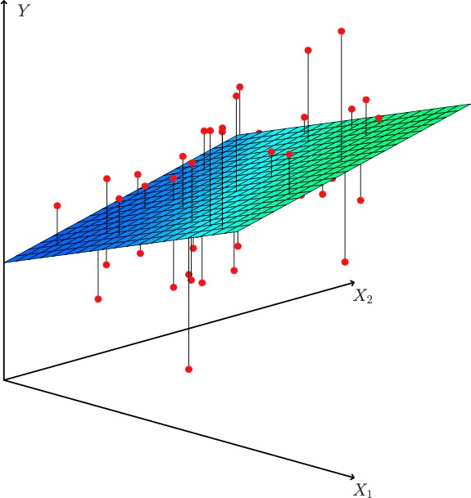
Least Squares Regression Plane
The figure shows the relationship between two predictor variables and a response variable.
Linear regression in this case gives a plane fit by minimizing the squared vertical distance between the observations and the plane.
6.2: Linear Regression

Slide 17
Important Questions
When working with multiple linear regression, we are often interested in several important questions.
Is there a relationship between the response and the predictors?
How well does the model fit the data?
Given a set of predictor values, what is the predicted response, and how accurate is our prediction? We will go over the methods for answering each of these questions.
6.2: Linear Regression

Slide 18
Hypothesis Test for Parameters
One: Is there a relationship between the response and the predictors?
We can address this question by testing whether the regression coeﬀicients are far enough from zero.
Our null hypothesis and alternative hypothesis are the following:
𝐻₀ ∶ 𝛽₁ = 𝛽₂ = ⋯ = 𝛽_{𝑝} = 0 𝐻_{𝑎} ∶ 𝛽_{𝑗} ≠ 0 for some 𝑗
The hypothesis can be tested with the F-statistic, which is defined by
(TSS − RSS)/𝑝
^{𝐹 =} RSS/(𝑛 − 𝑝 − 1).
If the 𝐹 -statistic is much larger than 1 we reject the null hypothesis and conclude there is a relationship between at least on the the predictors and the response. If the 𝐹 -statistic is close to 1, the 𝑝-value can be computed to determine the outcome.
6.2: Linear Regression

Slide 19
𝑅𝑆𝐸 and 𝑅²
Two: How well does the model fit the data?
The RSE and 𝑅² are measures of the model fit. In the multiple linear regression context, 𝑅²
is the square of the correlation between the response and the fitted linear model. That is,
𝑅² = Cor(𝑌 , 𝑌̂)².
The RSE is defined by
RSE = √ ^{RSS} where 𝑛 = # observations, 𝑝 = # predictors
𝑛 − 𝑝 − 1
Important considerations as the number of variables in the model increases:
𝑅² will increase even if the new variables have a weak association with the response.
𝑅𝑆𝑆 of the training data will decrease, but not necessarily that of the testing data.
𝑅𝑆𝐸 will increase if the decrease in 𝑅𝑆𝑆 is small relative to the increase in 𝑝.
6.2: Linear Regression

Slide 20
Prediction Accuracy
Three: Given a set of predictor values, what is the predicted response, and how accurate is our prediction? Once we have fit the multiple regression model, the response 𝑌 is predicted by
𝑌̂ = 𝛽₀̂ + 𝛽₁̂ 𝑋₁ + ⋯ + 𝛽_{𝑝}̂ 𝑋_{𝑝}.
There are three types of uncertainty associated with the prediction 𝑌
The reducible error arising from the inaccuracy of the coeﬀicient estimates.
The reducible error stemming from the assumption that the relationship between 𝑌 and 𝑋 is linear; model bias.
The irreducible error from the random error associated with the true response
𝑌 = 𝑓(𝑥) + 𝜖.
1
2
3
We can address how much 𝑌 will vary from 𝑌̂ using prediction intervals.
6.2: Linear Regression

Slide 21
Exercises: Multiple Linear Regression
Open the Linear Regression Exercises R Markdown or Jupyter Notebook file.
Go over the “Multiple Linear Regression” section together as a class.
6.2: Linear Regression

Slide 22
Qualitative Predictors
So far we have only looked at using quantitative predictor variables for linear regression. However, sometimes the inclusion of qualitative variables is desirable.
Suppose we have the following information about a set of people:
𝑌 : income (quantitative: $ amount)
𝑋₁: student status (qualitative: is a student or is not)
𝑋₂: location of residence (qualitative: Toronto, Vancouver, Montreal)
We want to determine whether there is a relationship between income and the other two qualitative variables.
6.2: Linear Regression

Slide 23
Qualitative Predictors: Two Levels
Let’s start by looking at the differences in income between students and non-students. Our qualitative predictor, or factor, has two levels so we can incorporate into a regression model using a dummy variable that takes on two possible numerical values.
if 𝑖th person is a student
𝑥 = { ¹
𝑖
0 if 𝑖th person is not a student
So we have the following model:
if 𝑖th person is a student
if 𝑖th person is not a student
𝑦 = 𝛽 + 𝛽 𝑥 + 𝜖 = { ^{𝛽0 + 𝛽1 + 𝜖𝑖}
𝑖 0 1 𝑖 𝑖
𝛽₀ + 𝜖_{𝑖}
𝛽₀ is the average income for non-students.
𝛽₀ +𝛽₁ is the average income for students.
The method for fitting linear models with qualitative predictors using dummy variables remains the same.
6.2: Linear Regression

Slide 24
Qualitative Predictors: Multiple Level
Now let’s look at the difference in income between the residents of Toronto, Vancouver, and Montreal. We can do this using two dummy variables.
if 𝑖th person is from Vancouver
𝑥 = { ¹
𝑖1
0 if 𝑖th person is not from Vancouver
if 𝑖th person is from Montreal
𝑥 = { ¹
𝑖2
0 if 𝑖th person is not Montreal
The level with no dummy variable is known as the baseline (Toronto in this example). Our model is now
if 𝑖th person is from Vancouver
{⎧ 𝛽₀ + 𝛽₁ + 𝜖_{𝑖}
𝑦_{𝑖} = 𝛽₀ + 𝛽₁𝑥_{𝑖1} + 𝛽₂𝑥_{𝑖2} + 𝜖_{𝑖} = ⎨ 𝛽₀ + 𝛽₂ + 𝜖_{𝑖} if 𝑖th person is from Montreal
⎩{ 𝛽₀ + 𝜖_{𝑖} if 𝑖th person is from Toronto.
6.2: Linear Regression

Slide 25
Qualitative Predictors: Multiple Levels
𝛽₀ + 𝛽₁ + 𝜖_{𝑖} if 𝑖th person is from Vancouver
𝑦_{𝑖} = 𝛽₀ + 𝛽₁𝑥_{𝑖1} + 𝛽₂𝑥_{𝑖2} + 𝜖_{𝑖} = ⎨ 𝛽₀ + 𝛽₂ + 𝜖_{𝑖} if 𝑖th person is from Montreal
𝛽₀ + 𝜖_{𝑖} if 𝑖th person is from Toronto.
The coeﬀicients can be interpreted as
𝛽₀ the average income for people from Toronto
𝛽₁ the difference in the average income between people from Vancouver versus Toronto
𝛽₂ the difference in the average income between people from Montreal versus Toronto.
1
The choice of 0 and 1 as values for the dummy variable or the choice of the baseline category are arbitrary and will not change the results of the regression
These choices will impact the interpretation of the coeﬀicients and their 𝑝-values. Use an F-test to test 𝐻₀ : 𝛽₁ = 𝛽₂ = 0.
2
3
6.2: Linear Regression

Slide 26
Exercises: Qualitative Predictors
Open the Linear Regression Exercises R Markdown or Jupyter Notebook file.
Go over the “Qualitative Predictors” section together as a class.
6.2: Linear Regression

Slide 27
Extensions of the Linear Model
Two of the most important and restrictive assumptions for linear regression models are The relationship between the predictors and the response is additive.
⇒ The association between a predictor and the response does not depend on any of the other predictors.
The relationship between the predictors and the response is linear.
⇒ A one-unit change in a predictor induces a constant change in the response regardless of the value of the predictor.
We will examine the relaxation of the additive assumption but modifications to the linear assumption will be left until section 6.6.
6.2: Linear Regression

Slide 28
Removing the Additive Assumption
Consider the following linear regression model with two predictors
𝑌 = 𝛽₀ + 𝛽₁𝑋₁ + 𝛽₂𝑋₂ + 𝜖
We can include the product of 𝑋₁ and 𝑋₂ as a third predictor called the interaction term.
𝑌 = 𝛽₀ + 𝛽₁𝑋₁ + 𝛽₂𝑋₂ + 𝛽₃𝑋₁𝑋₂ + 𝜖
This means that a change in the value of 𝑋₂ will change the association between 𝑋₁ and 𝑌 .
We can look at the 𝑝-value for 𝐻₀ ∶ 𝛽₃ = 0 to determine whether the interaction term is justified.
The hierarchical principal: when including an interaction in a model, the main effects should also be included even if the 𝑝-values for these coeﬀicients are not significant.
6.2: Linear Regression

Slide 29
Exercises: Interaction Term
Open the Linear Regression Exercises R Markdown or or Jupyter Notebook file.
Go over the “Interaction Term” section together as a class.
6.2: Linear Regression

Slide 30
Potential Problems
There are quite a few problems that can arise when fitting a linear regression model to a data set.
Non-linear response-predictor relationship Correlation of error terms
Non-constant variance of error terms Outliers
High-leverage points
We will briefly explain how to identify these problems but we will wait to provide solutions until later sections within this module.
6.2: Linear Regression

Slide 31
Non-Linearity
Linear regression assumes a linear relationship between the predictors and the response. If this assumption is invalid then conclusions derived from the model are flawed.
Identification:
Plot the residuals 𝑒_{𝑖} = 𝑦_{𝑖} − 𝑦_{𝑖}̂ versus the predictor 𝑥_{𝑖} (or versus 𝑦_{𝑖} in the case of multiple regression)
There should be no discernible pattern in the residuals, otherwise this may indicate non-linearity.
6.2: Linear Regression

Slide 32
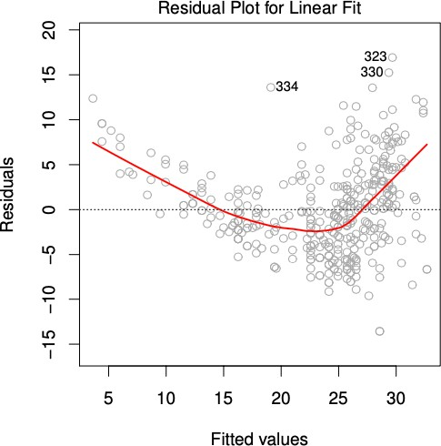
Non-Linearity
Plot of the residuals versus the predicted values for a linear regression fit to a dataset.
There is a clear trend in the residuals illustrated by the red curve which could indicate patterns in the data that are not captured by the linear model.
6.2: Linear Regression

Slide 33
Correlation of Errors
Linear regression assumes that the error terms 𝜖₁, 𝜖₂, … , 𝜖_{𝑛} are uncorrelated (i.e. the value of
𝜖_{𝑖} is unrelated to the value for 𝜖_{𝑖+1}). If this is violated, the estimated standard errors are much smaller than the truth, leading to unwarranted confidence in the model.
Examples
correlation between consecutive observations in time series data.
observations are related in some other way (ex: individuals are members of the same family or have been exposed to the same environmental factors).
Identification for time series: Plot residuals v time
Look for temporal patterns that could indicated correlation of error terms.
6.2: Linear Regression

Slide 34
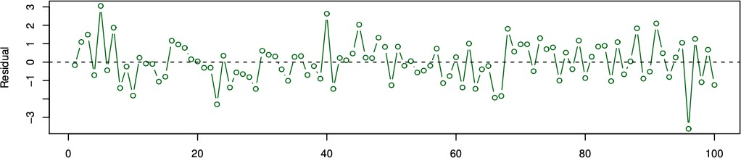
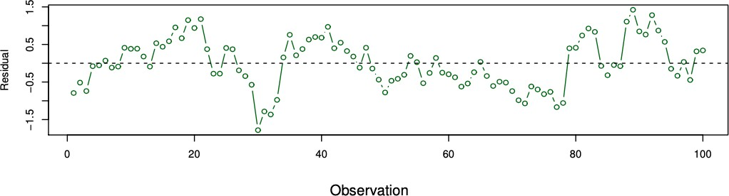
Correlation of Errors
Both plots show the residuals from a linear regression fit to time series data versus time. The top plot shows no correlation between the residuals whereas the bottom plot clearly has a time dependent structure.
6.2: Linear Regression

Slide 35
Non-Constant Variance of Errors
Linear regression also assumes constant variance of the error terms, Var(𝜖_{𝑖}) = 𝜎². If this assumption is invalid, the standard errors, confidence intervals, and hypothesis tests for the linear model are undermined.
Identification:
Plot the residuals versus the response.
Look for a funnel shape in the plot (this indicates an increase or decrease in the variance of the errors as a function of the response)
1
2
6.2: Linear Regression

Slide 36
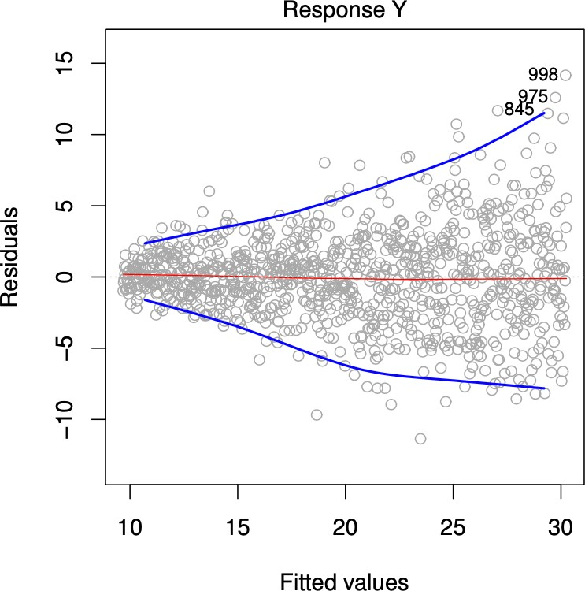
Non-Constant Variance of Errors
Plot for the residuals versus the fitted values of a linear regression model.
The residuals show a clear funnel shape with increasing response values resulting in increasing variance of the error terms.
6.2: Linear Regression

Slide 37
Outliers
Outliers are data points that have unusual values for 𝑦_{𝑖} given an unremarkable 𝑥_{𝑖}. That is, 𝑦_{𝑖} is far from the value predicted by the model for 𝑥_{𝑖}. Outliers can occur as a result of an error in data collection or a variety of other reasons.
Outliers often have little effect on the parameter fitting, but they can alter the 𝑅𝑆𝐸 and 𝑅²
which can impact the interpretation of the fit.
Identification:
1
Plot the studentized residuals which are computed by dividing the residuals 𝑒_{𝑖} by the estimated standard error.
Observations with studentized residuals greater than 3 or less than -3 are probably outliers.
2
6.2: Linear Regression

Slide 38
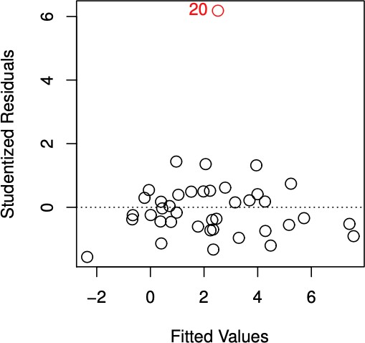
Outliers
Plot of the studentized residuals versus the response values.
The red point at the top of the plot is above 3 which indicates it is an outlier.
6.2: Linear Regression

Slide 39
High Leverage Points
High leverage points are observations that have an unusual predictor value. These points tend to impact the fitted regression quite a bit and are therefore very important to identify.
Identification:
In simple linear regression, look for observations with a predictor value that is far outside the range of the rest.
In multiple regression, we are looking for an unusual combination of predictors which can be harder to identify
Compute the leverage statistic for each observation.
If the leverage statistic is much greater than (𝑝 + 1)𝑛, the observation may have high leverage.
6.2: Linear Regression

Slide 40
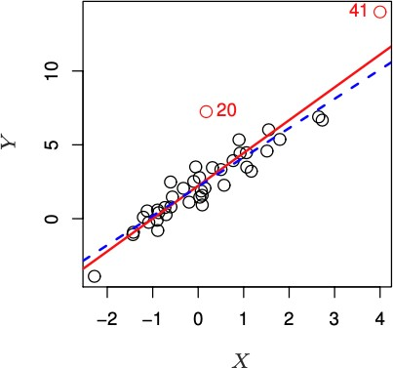
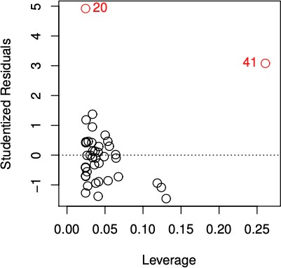
High Leverage Points
The left plot shows the response versus the predictors for a simple linear regression. The right plot show the studentized residuals versus the leverage.
Observation 41 in the left plot has a very large predictor value which indicates it is a high leverage point. This is confirmed in the right plot by the leverage index. The right plot also indicates 41 has a larger studentized residual (as does observation 20) so 41 is an outlier and a high leverage point.
6.2: Linear Regression

Slide 41
Exercises
Open the Linear Regression Exercises R Markdown or or Jupyter Notebook file.
Go over the “Helpful Plots” section together as a class. Complete the exercises at the end of the file.
6.2: Linear Regression

Slide 42
References
Chapter 3 of the ISLR2 and ISLP books:
James, Gareth, et al. “Linear Regression.” An Introduction to Statistical Learning: with Applications in R, 2nd ed., Springer, 2021.
James, Gareth, et al. “Linear Regression.” An Introduction to Statistical Learning: with Applications in Python, Springer, 2023.
6.2: Linear Regression

